Slide 1
Campaign Training

Slide 2
What is a campaign?
Your overall strategy to get people to vote for you.
Manifesto
Campaign Material
Messaging – where you share this and how.
Social Media

Slide 3
Your “Message”
Be clear on what you stand for and the change you want
The key things you want people to take away.
10-15 seconds

Slide 4
Campaign Theme
Consistency is key – want people to recognise you.
How?
Colours
Mascot
Slogan/Hashtags
Don’t stress, vote Jess!
Don’t be a wally, vote for Hollie!
#BackBrooks

Slide 5
Campaigning – Posters/Flyers
Posters/Flyers – support your manifesto.
Material should include:
Your name
A photo of you
The position you’re running for
Voting dates
SU website - wolvesunion.org/vote/
DPS can print materials if you want.

Slide 6
Campaigning – Posters/Flyers
Know your audience – not everything appeals to everyone
Consistent design
Check you can do what you want BEFORE doing it – get these approved
Don’t rely on posters to get your message out – they’re passive media
Remember people see thousands of messages a day
Don’t use flyers to give a message – use them to reinforce your point
Keep flyers on brand with your other materials
Don’t overload people

Slide 7
Campaigning – In Person
Make a plan in advance – when is most effective?
Communal Areas
Lecture Shoutouts
Accommodation – communal areas
All Campuses – City, Walsall, Telford

Slide 8
Campaigning – In Person
Be polite
Try to avoid the ‘do you have a minute?’ techniques
Have a clear message before you start to speak
Be confident
Give them things to take away to remember you by
Be personable – don’t treat people as a vote
Follow up on conversations
Practice questions people are likely to ask

Slide 9
Campaigning – Social Media
SU Pages – already garnered following.
Campaign Pages – FB/Twitter/Instagram
Videos
Jason - Co-President Sports & Development (Thrift Shop Cover Parody) - YouTube
Vote Alex Reilly - #1 President Education & Campaigns - YouTube
TikTok?

Slide 10
Campaigning – Social Media
Social media is powerful; be creative and strategic here
Don’t bombard people with information
Vary your approach
Be aware of who you’re targeting
Respect that some people don’t want to be bothered on social media
Play by the rules online as you would offline

Slide 11
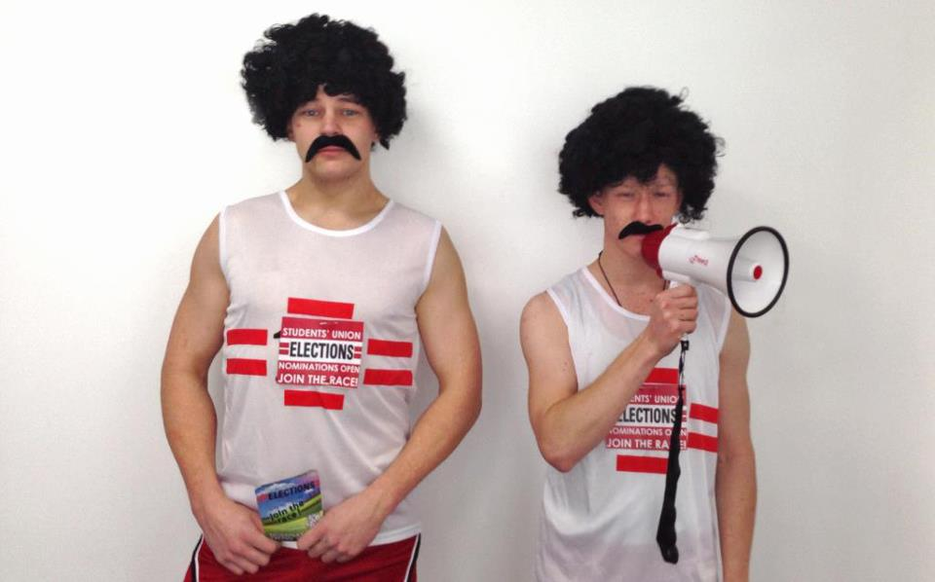
Stand Out
Flashmobs
Videos
Events
Stunts
Freebees
Be out of the ordinary
Be visible
Stand out

Slide 12
Useful Resources
Canva
Video Editor/iMovie
Grammar Checker
Potential to earn extra
£5

Slide 13
Reminder
£25
Stick to your budget
Items you use in any videos etc. can be costed by the SU team.
Campaigning begins Feb 27th
Per candidate
Potential to earn extra
£5
If you bring 5 people to Candidate Question Time

Slide 14
Get planning!

